Slide 1
SHORTEST PATH
MADE BY:
ALISHER YEGIZOV SULTAN
ZHUSSUPALI SALAMAT YERMAKHAN
ZHUANDYK
KUANYSHBEKOV

Slide 2
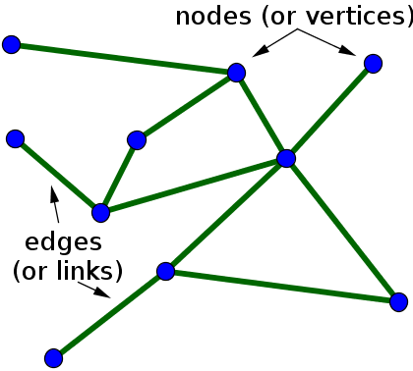
REAL- LIFE GRAPHS
Graph theory is the study of graphs, which are mathematical structures used to model pairwise relations between objects. A graph in this context is made up of vertices (also called nodes or points) which are connected by edges.

Slide 3

EVERYTHING IN OUR WORLD IS LINKED:
ALL CITIES
PAGES ARE FLIGHT AND
ARE LINKED BY ROADS
LINKED BY HYPERLINKS RAIL NETWORK
ON THE INTERNET
MOBILE NETWORK
COMPONENTS OF COMPONENTS OF
ELECTRIC CIRCUIT
CHIPS AND
COMPUTER
ETC…
By graphs, we can simulate all these networks to make some visual analysis like finding connections and shortest paths between nodes.

Slide 4
DIJKSTRA
ALGORITHM
ALGORITHMS
BELLMAN- FORD ALGORITHM

Slide 5

ALGORITHM
WHAT IS DIJKSTRA’S SHORTEST PATH ALGORITHM?
DIJKSTRA ALGORITHM IS A GREEDY ALGORITHM.
IT FINDS A SHORTEST PATH TREE FOR A WEIGHTED UNDIRECTED GRAPH.
HIS MEANS IT FINDS A SHORTEST PATHS BETWEEN NODES IN A GRAPH, WHICH MAY REPRESENT, FOR EXAMPLE, ROAD NETWORKS
FOR A GIVEN SOURCE NODE IN THE GRAPH, THE ALGORITHM FINDS THE SHORTEST PATH BETWEEN SOURCE NODE AND EVERY OTHER NODE.
THIS ALGORITHM ALSO USED FOR FINDING THE SHORTEST PATHS FROM A SINGLE NODE TO A SINGLE DESTINATION NODE BY STOPPING THE ALGORITHM ONCE THE SHORTEST PATH TO THE DESTINATION
NODE HAS BEEN DETERMINED.
DIJKSTRA’ S ALGORITHM IS SPANNING TREE ( MST) AND SOURCE..
VERY SIMILAR TO PRIM’ S ALGORITHM. IN PRIM’ S ALGORITHM WE CREATE MINIMUM IN DIJKSTRA ALGORITHM WE CREATE SHORTEST PATH TREE ( SPT) FROM THE GIVEN

Slide 6

ALGORITHM
WHAT IS BELLMAN- FORD’S SHORTEST PATH ALGORITHM?
THE BELLMAN- FORD ALGORITHM BETWEEN A GIVEN SOURCE VERTEX
IS A GRAPH SEARCH ALGORITHM AND ALL
THAT FINDS THE GRAPH.
THE SHORTEST PATH
THIS ALGORITHM CAN BE
OTHER VERTICES IN USED ON BOTH WEIGHTED AND UNWEIGHTED GRAPHS.
LIKE
DIJKSTRA' S
SHORTEST
PATH
ALGORITHM, THE
BELLMAN- FORD ALGORITHM IS GUARANTEED TO FIND
THE SHORTEST PATH IN A GRAPH. THOUGH IT IS SLOWER THAN DIJKSTRA' S ALGORITHM, BELLMAN- FORD IS CAPABLE OF HANDLING GRAPHS THAT CONTAIN NEGATIVE EDGE WEIGHTS, SO IT IS MORE VERSATILE.
IT IS WORTH NOTING THAT IF SHORTEST PATH. GOING AROUND TO DECREASE THE COST OF THE THIS, BELLMAN- FORD CAN ALSO
THERE EXISTS A NEGATIVE CYCLE IN THE GRAPH, THEN THERE IS NO
THE NEGATIVE CYCLE AN INFINITE NUMBER OF TIMES WOULD CONTINUE PATH ( EVEN THOUGH THE PATH LENGTH IS INCREASING). BECAUSE OF DETECT NEGATIVE CYCLES WHICH IS A USEFUL FEATURE.

Slide 7
SHORTEST PATH APPLICATIONS

Slide 8

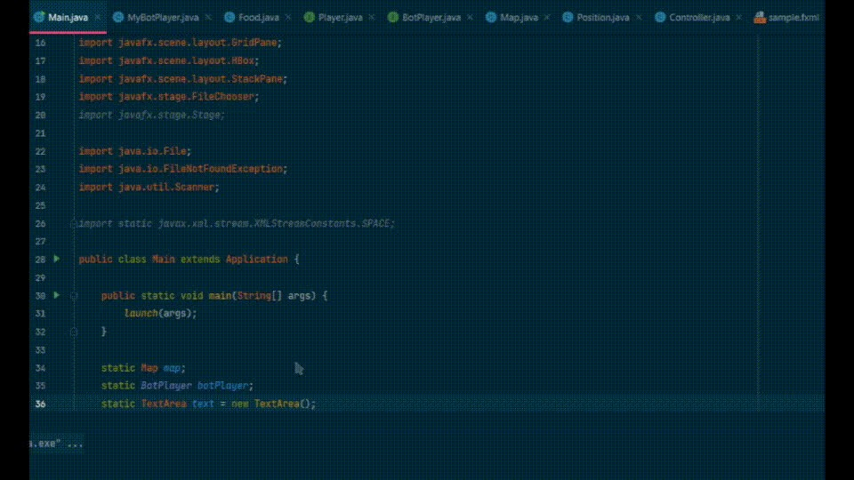
GAMES
What about uses of the shortest path algorithms, the very first thing that came to our mind was the project we worked on in the java2 course.
Gif: https://drive.google.com/drive/folders/1S7sY4jWE29hvo9_DolZS5-yhzcuXMTp_?usp=sharing

Slide 9


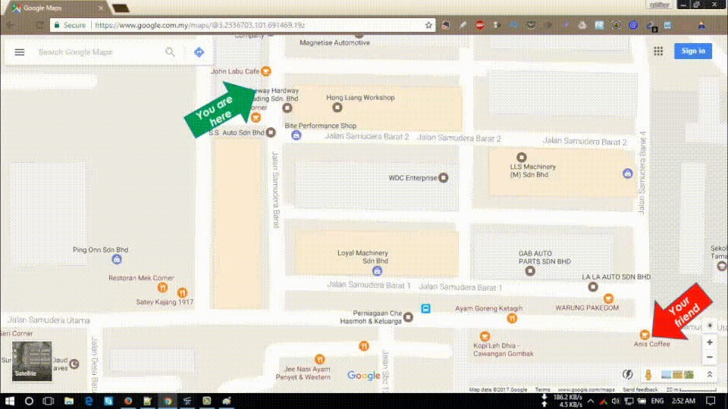
MAP SERVICES
Shortest path algorithms are applied to automatically find directions between physical locations, such as driving directions on web mapping websites like MapQuest or Google Maps.
Gif: https://drive.google.com/drive/folders/1ppboprlLA8NMHf3cf2_qMyodLfGZR3v0?usp=sharing

Slide 10
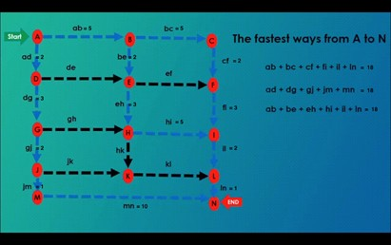
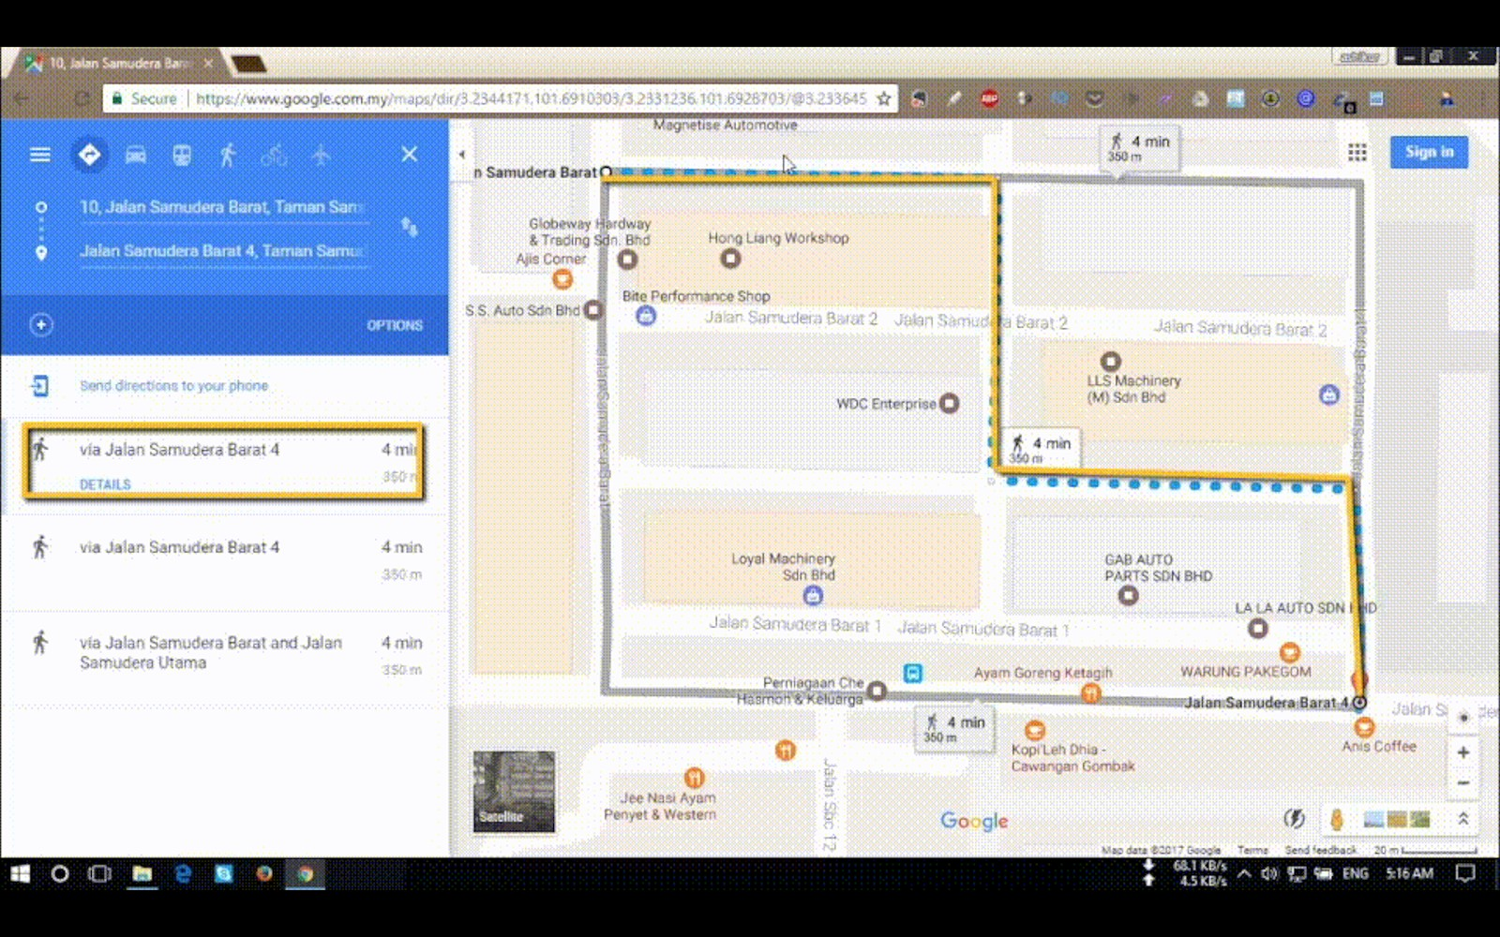
ANALYSIS AND GOOGLEMAPS RESULTS FROM GIF:

Slide 11

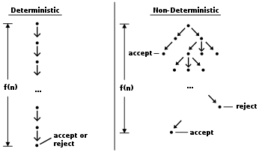
NONDETERMINISTIC MACHINE
If one represents a nondeterministic abstract machine as a graph where vertices describe states and edges describe possible transitions, shortest path algorithms can be used to find an optimal sequence of choices to reach a certain goal state.

Slide 12
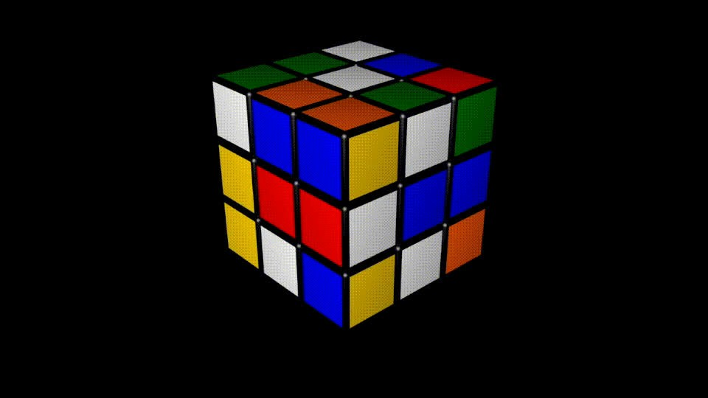
REAL LIFE EXAMPLE:
Gif: https://drive.google.com/drive/folders/13W2GZKHRodoSSOcLbwWxK61MigXJRUrL?usp=sharing
All of these algorithms work in two phases. In the first phase, the graph is preprocessed without knowing the source or target node. The second phase is the query phase. In this phase, source and target nodes are known. The idea is that the final node is static, so the preprocessing phase can be done once and used for a large number of queries on the same graph.

Slide 13
CODE

Slide 14
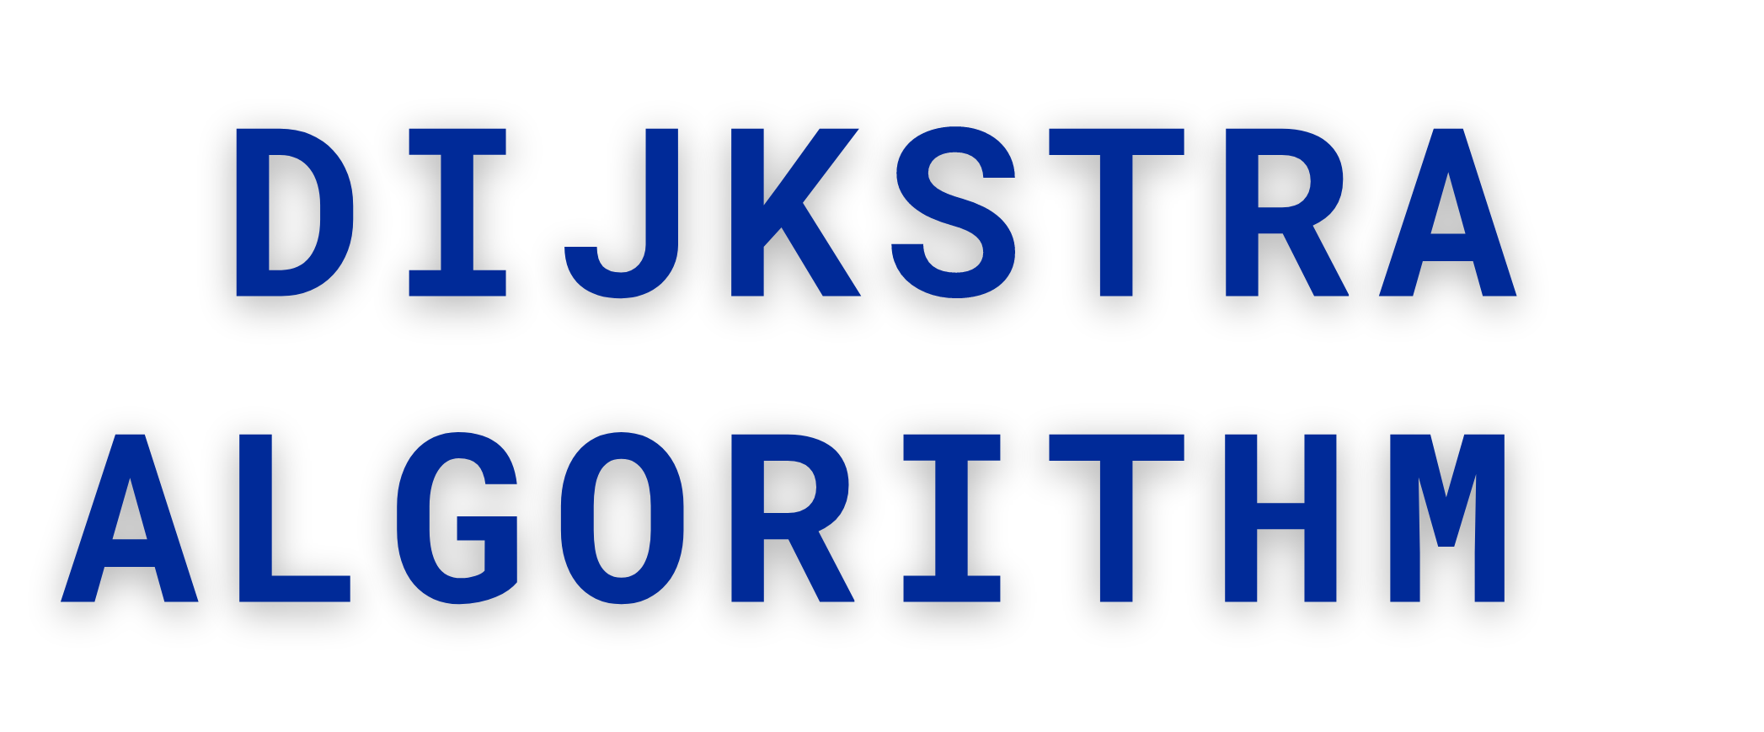
public class SPT { static class Graph {
int vertices; int matrix[][];
public Graph( int vertex) { this. vertices = vertex;
matrix = new int[ vertex][ vertex];
}
public void add Edge( int v, int w, int c) { matrix[ v][ w] = c;
matrix[ w][ v] = c;
}
int get Min Vertex( boolean[] list, int[] key) { int min Key = Integer. MAX_ VALUE;
int vertex = - 1 ;
for ( int i = 0 ; i < vertices; i++) {
if ( list[ i] == false && min Key > key[ i]) { min Key = key[ i];
vertex = i;
}
}
return vertex;
}
public void get Min Dist( int source Vertex) { boolean[] spt = new boolean[ vertices]; int[] distance = new int[ vertices]; int INFINITY = Integer. MAX_ VALUE;
for ( int i = 0 ; i < vertices; i++) { distance[ i] = INFINITY;
}
//
//
//
//
//
//
for ( int i = 0 ; i < vertices; i++) {
for ( int j = 0 ; j < vertices; j++) { System. out. print( matrix[ i][ j] + " ");
}
System. out. println();
}
distance[ source Vertex] = 0 ;
for ( int i = 0 ; i < vertices; i++) {
int vertex_ U = get Min Vertex( spt, distance);
System. out. println(" Vertex from get Min Vertex spt[ vertex_ U] = true;
//
equals " + vertex_ U);

Slide 15
System. out. print("[ ");
//
//
//
//
for ( int j = 0 ; j < spt. length; j++) { System. out. print( spt[ j] + " ");
}
System. out. println("]");
for ( int vertex_ V = 0 ; vertex_ V < vertices; vertex_ V++) {
if ( matrix[ vertex_ U][ vertex_ V] > 0 && spt[ vertex_ V] == false) { System. out. println(" Matrix " + matrix[ vertex_ U][ vertex_ V]); System. out. println(" Distance " + distance[ vertex_ U]);
int distance Update = matrix[ vertex_ U][ vertex_ V] + distance[ vertex_ U]; System. out. println(" Sum of Matrix + Distance " + distance Update);
if ( distance Update < distance[ vertex_ V]) distance[ vertex_ V] = distance Update;
}
//
//
//
}
}
//
//
//
//
// print shortest path tree
System. out. println( " Source Vertex " + source Vertex); for ( int i = 0 ; i < distance. length; i++) {
System. out. println( i + " distance " + distance[ i]);
}
print SPT( source Vertex, distance);
}
public void print SPT( int source Vertex, int[] System. out. println(" SPT Algorithm: "); for ( int i = 0 ; i < vertices; i++) {
System. out. println(" Source Vertex: " " distance: " + key[ i]);
}
}
key) {
+ source Vertex + " to vertex " + i +
}
public static void main( String[] args) { Graph graph = new Graph( 6 );
int source Vertex = 0 ; graph. add Edge( 0 , 1 , 4 );
graph. add Edge( 0 , 2 , 3 );
graph. add Edge( 1 , 2 , 1 );
graph. add Edge( 1 , 3 , 2 );
graph. add Edge( 2 , 3 , 4 );
graph. add Edge( 3 , 4 , 2 );
graph. add Edge( 4 , 5 , 6 ); graph. get Min Dist( source Vertex);
}
}

Slide 16
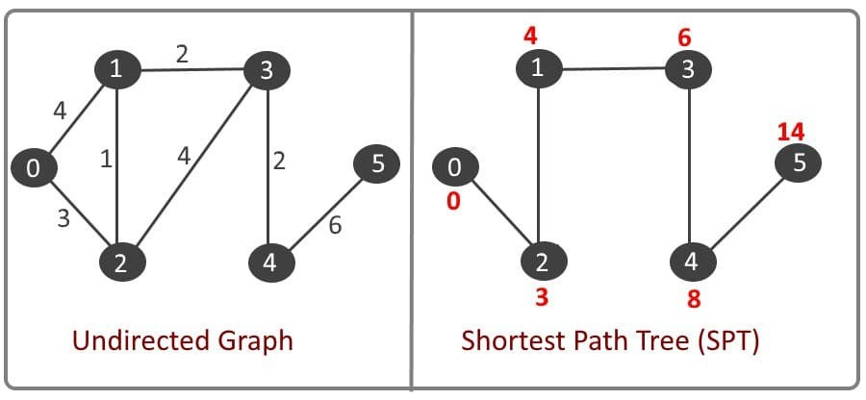
GRAPH REPRESENTATION:

Slide 17
public class SPT 2 {
static void Bellman Ford( int graph[][], int V, int E, int int [] dis = new int[ V];
for ( int i = 0 ; i < V; i++) { dis[ i] = Integer. MAX_ VALUE;
}
src) {
dis[ src] = 0 ;
for ( int i = 0 ; i < V - 1 ; i++)
{
for ( int j = 0 ; j < E; j++)
{
if ( dis[ graph[ j][ 0 ]] != Integer. MAX_ VALUE &&
dis[ graph[ j][ 1 ]])
dis[ graph[ j][ 1 ]] = dis[ graph[ j][ 0 ]] + graph[ j][ 2 ];
}
dis[ graph[ j][ 0 ]] + graph[ j][ 2 ] <
}
for ( int i = 0 ; i < E; i++) { int x = graph[ i][ 0 ];
int y = graph[ i][ 1 ];
int weight = graph[ i][ 2 ];
if ( dis[ x] != Integer. MAX_ VALUE && dis[ x] + weight < dis[ y])
System. out. println(" Graph contains negative"
+" weight cycle");
}
System. out. println(" Vertex Distance from Source"); for ( int i = 0 ; i < V; i++)
System. out. println( i + "\ t\ t" + dis[ i]);
}
public static void main( String[] args) {
int V = 5 ; // Number of vertices in graph int E = 8 ; // Number of edges in graph
int graph[][] = { { 0 , 1 , - 1 }, { 0 , 2 , 4 },
{ 1 , 2 , 3 }, { 1 , 3 , 2 },
{ 1 , 4 , 2 }, { 3 , 2 , 5 },
{ 3 , 1 , 1 }, { 4 , 3 , - 3 } };
Bellman Ford( graph, V, E, 0 );
}
}
BELLMAN-FORD
ALGORITHM

Slide 18
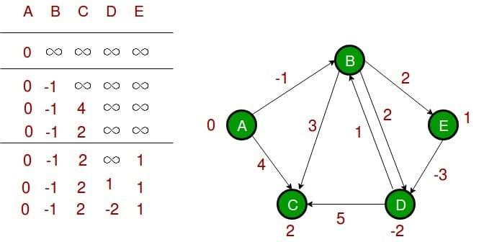
GRAPH REPRESENTATION:

Slide 19
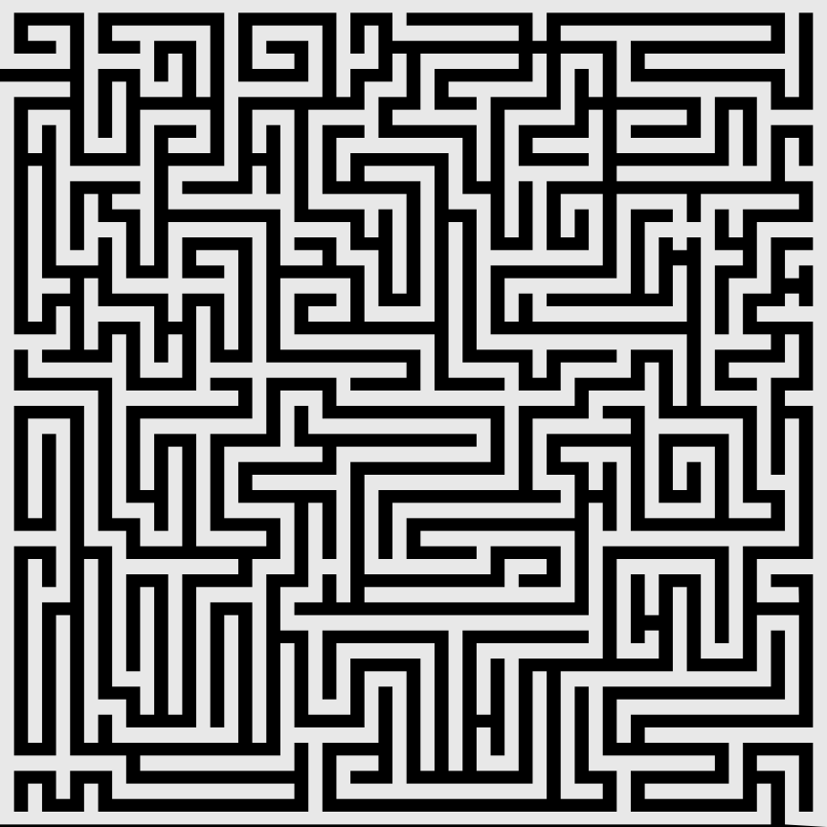
THANK YOU
FOR YOUR ATTENTION

